Slide 1
2018
R-CNN
汇报人：孙树铭

Slide 2
Title
Rich feature hierarchies for accurate object detection and semantic segmentation
paper

Slide 3
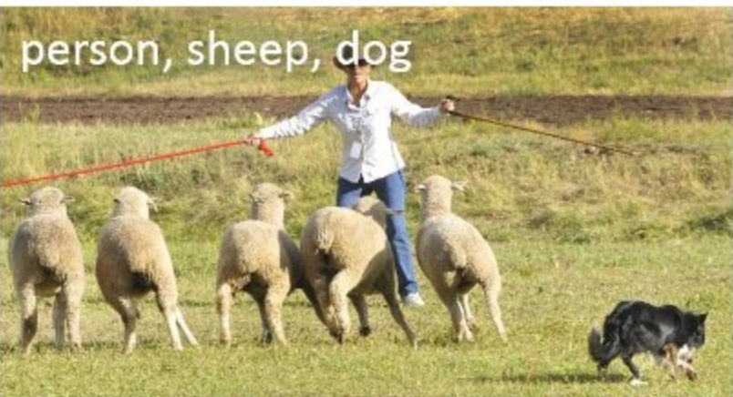
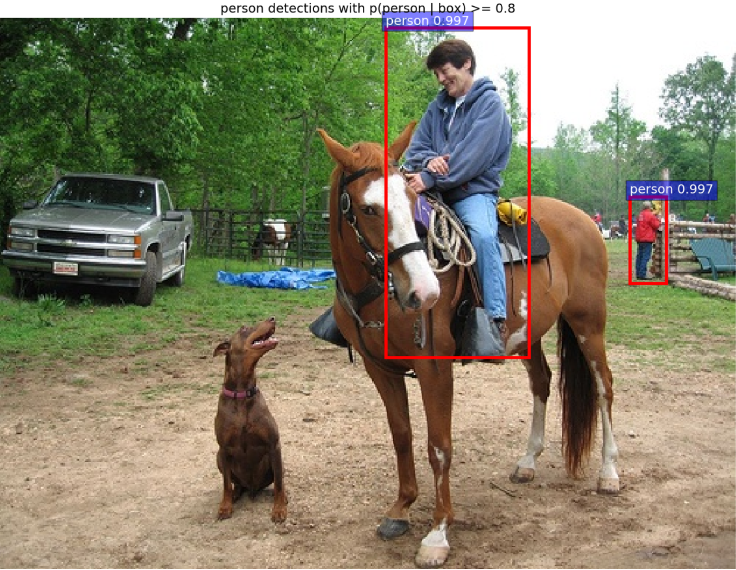
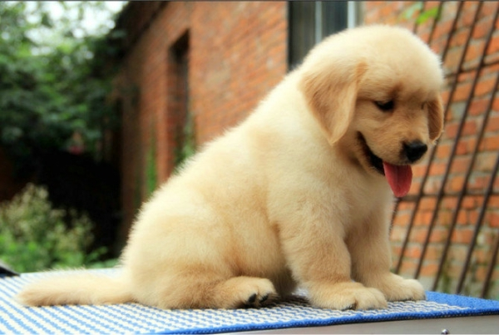
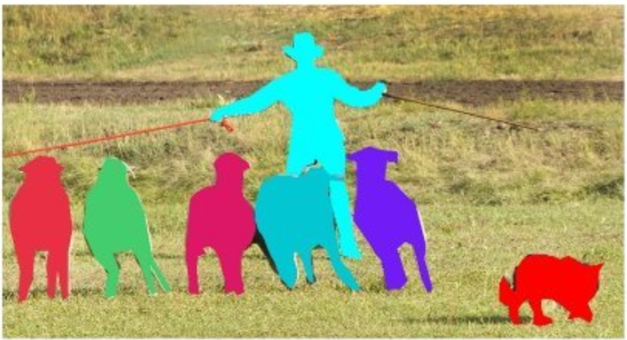
Classical Computer Vision Task
dog
Classification
Object detection
Instance segmentation

Slide 4
Object detection
2012
Alexnet
Object detection
classification

Slide 5
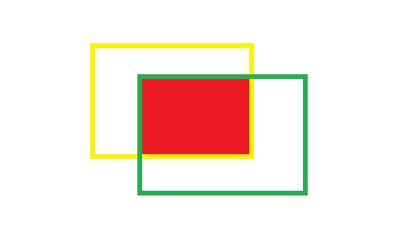
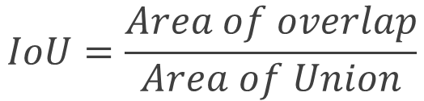
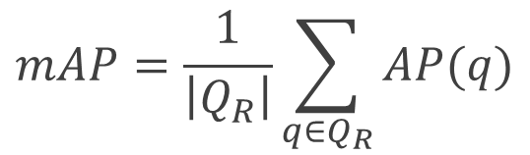
Fundamental concept
Intersection over union
$$IoU=\frac{Area of overlap}{Area of Union}$$
$$mAP=\frac{1}{\left|Q_{R}\right|}\sum_{q∈Q_{R}}{AP(q)}$$
Mean average precision

Slide 6
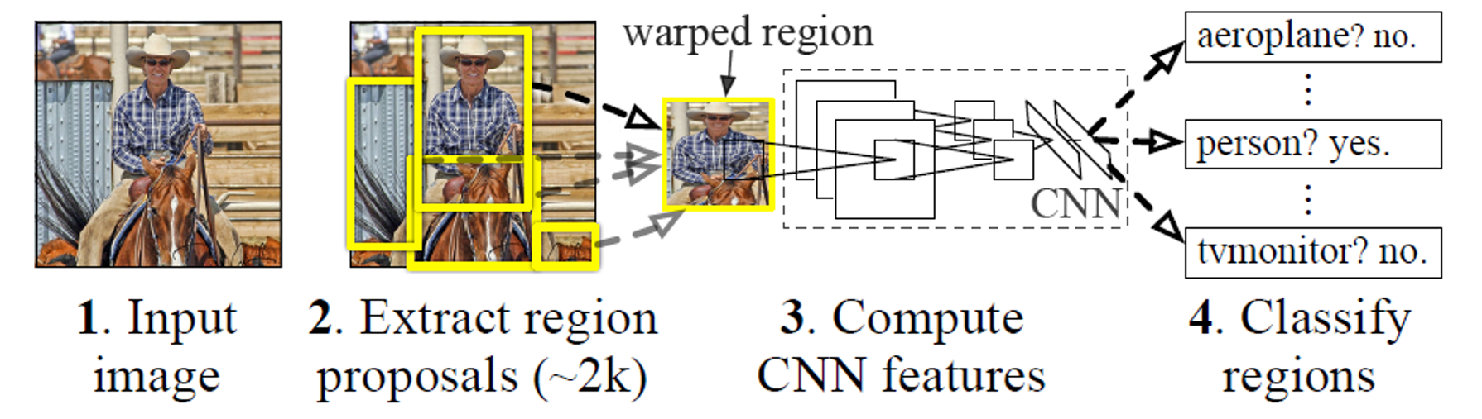
Region with CNN features

Slide 7
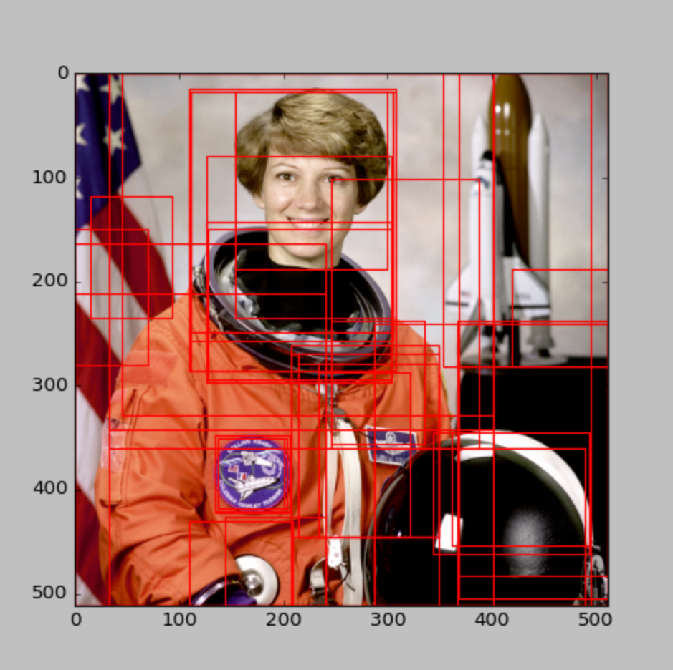
Region Proposals
Selective Search

Slide 8
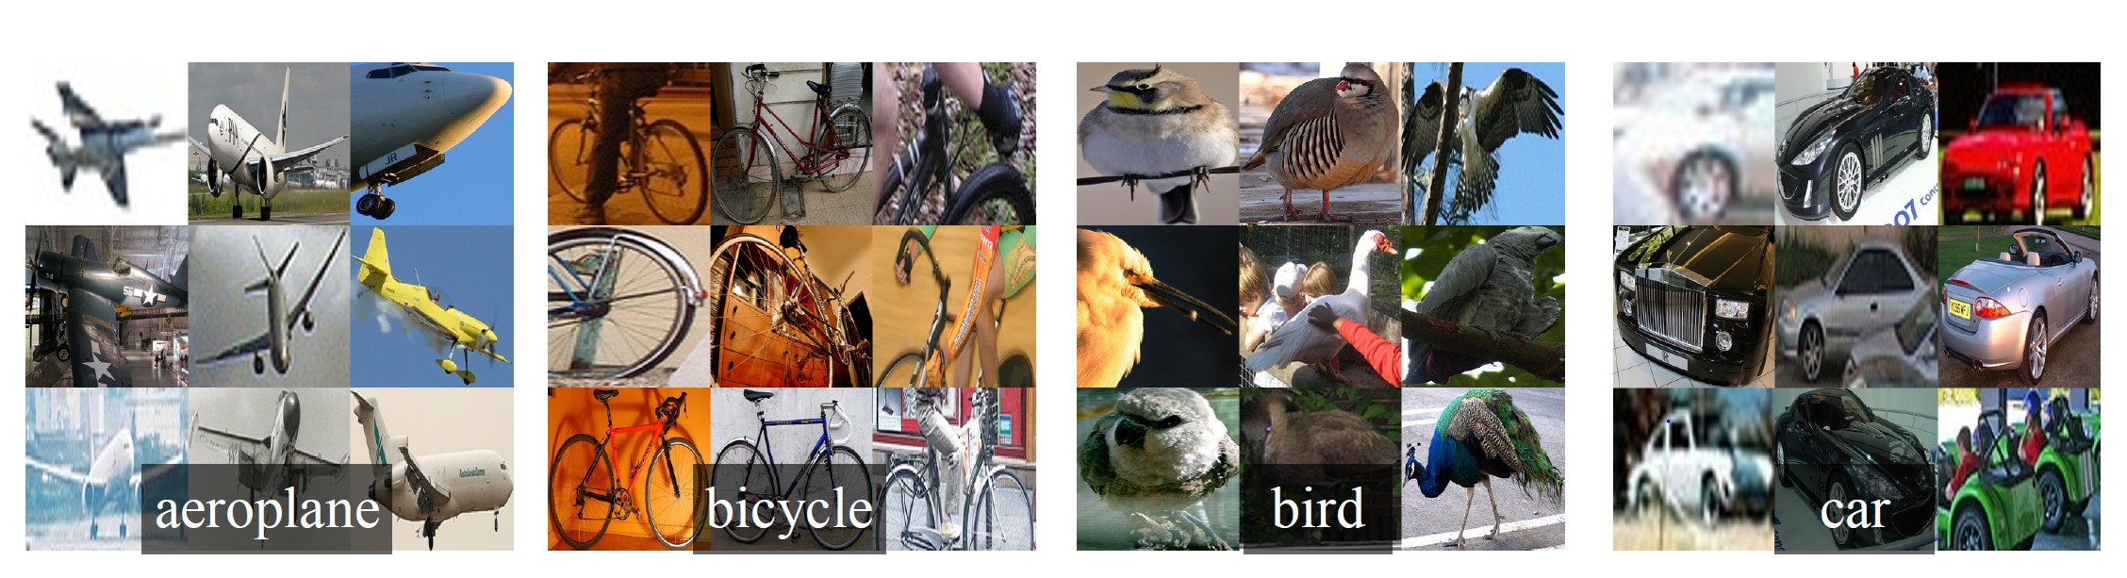
Warp region

Slide 9
Training CNN
Supervised pre-training
ILSVRC2012
Replace Imagenet-specific 1000-way classification with (N+1)-way classification layer
Fine-tuning

Slide 10


Training CNN
Positive samples
$$IoU≥0.5$$
Negative samples
$$IoU≤0.5$$

Slide 11
Training SVM
Features computed by the ImageNet pre-trained CNN
input
output
Binary classifier

Slide 12

Training SVM
Positive samples
Ground-truth boxes
Negative samples
$$IoU≤0.3$$

Slide 13
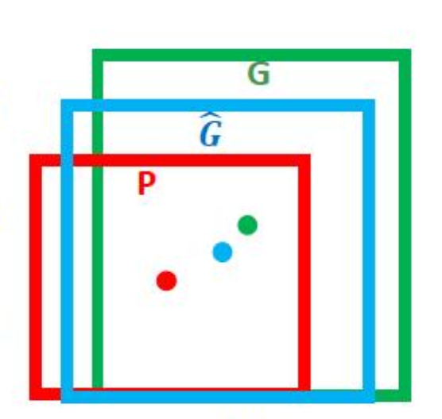
Bounding-box regression
Regress features computed by CNN
Learn a transformation that maps a proposed box P to ground-truth G

Slide 14
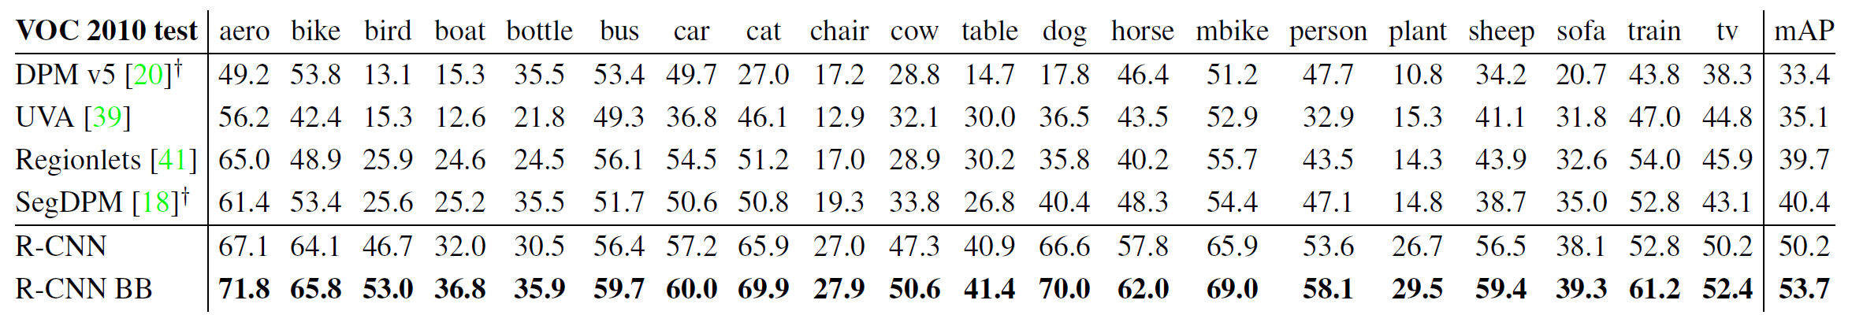
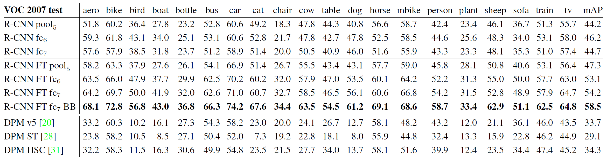
Results on datasets

Slide 15
Drawbacks
Training is a multi-stage pipeline
Training is expensive in space and time
Object detection is slow

Slide 16
THANKS!
汇报人：孙树铭

